Slide 1
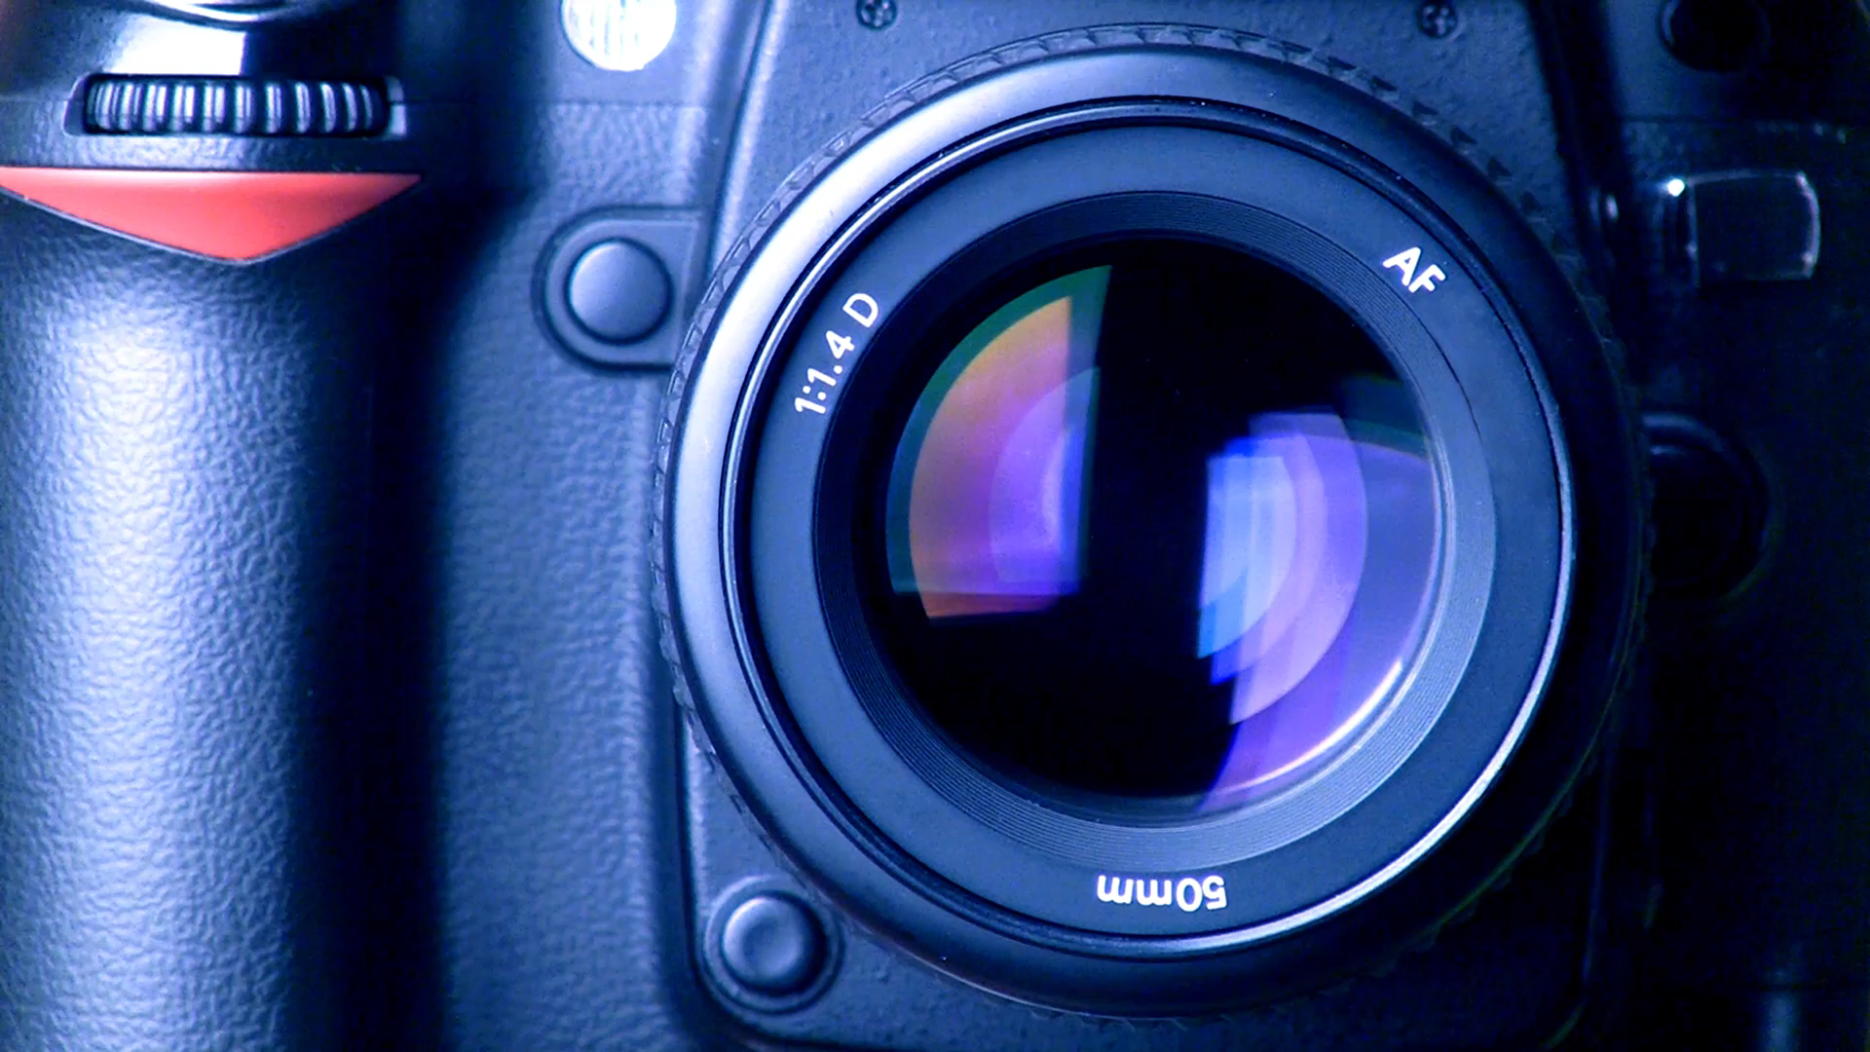
Photo Share App
Murat Kerem SERTTAŞ
1201602813
Swift & Storybaoard

Slide 2
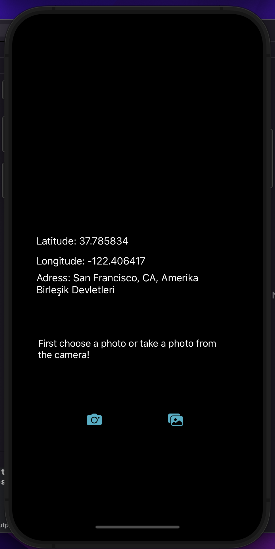
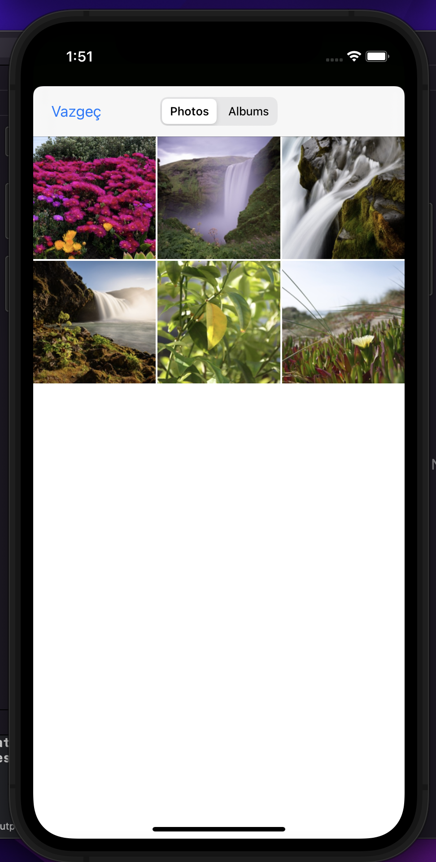
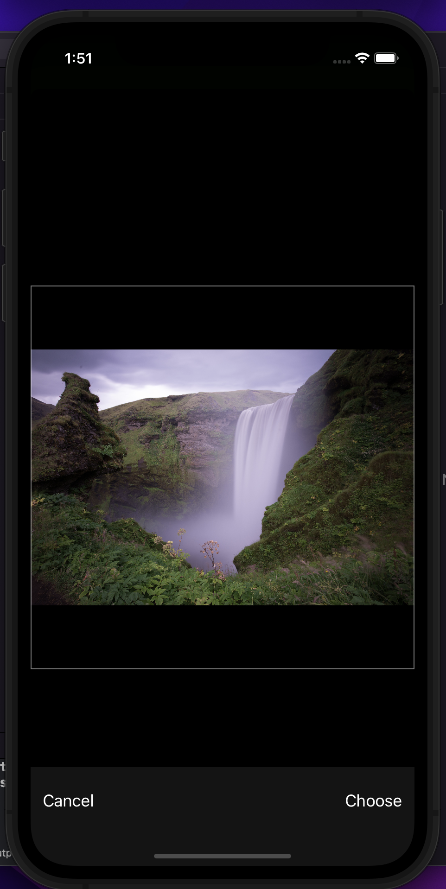
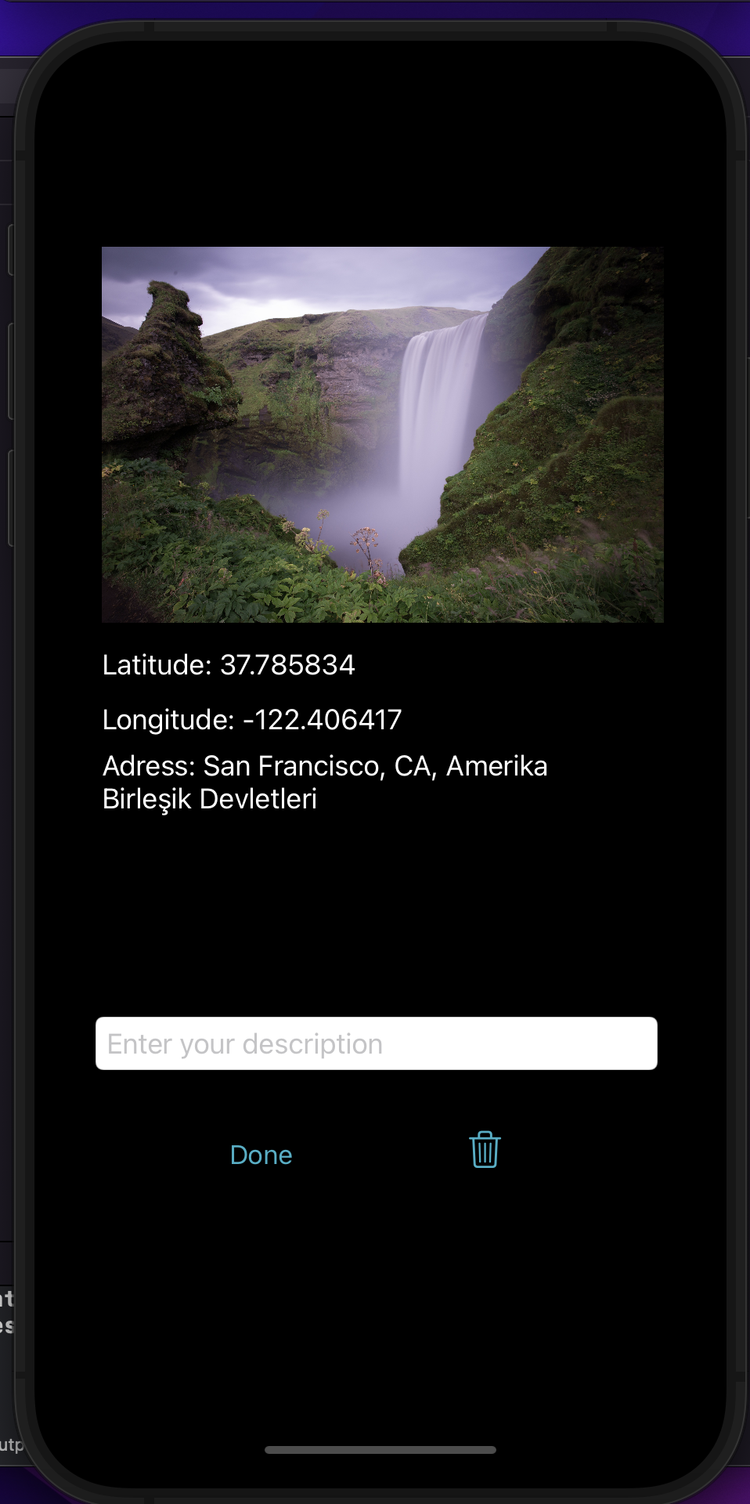

Slide 3



Components Actions Functions
cameraButton
cameraPreview
PhotoLibraryButton
PhotoLibraryPrview
Btngotosht
ScreenShotButton
Latitude
Longitude
Address
viewLabel
textBox
clearButton
firstDescription
cameraActionController checkPermisson
requestAuthorizationHandler
tappedLibraryButton imagePickerController
Navigate
ScreenShot takeScreenShot(extension)
locationConfig
locationManager
ClearData

Slide 4
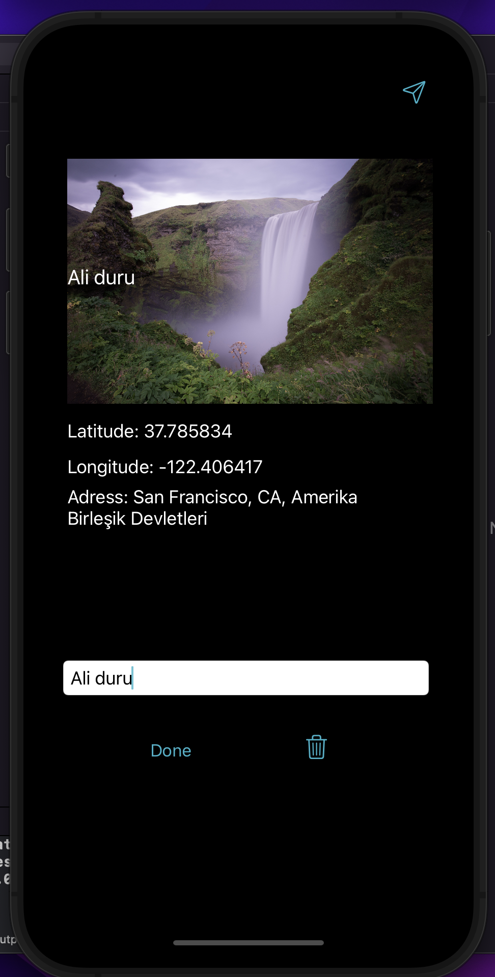
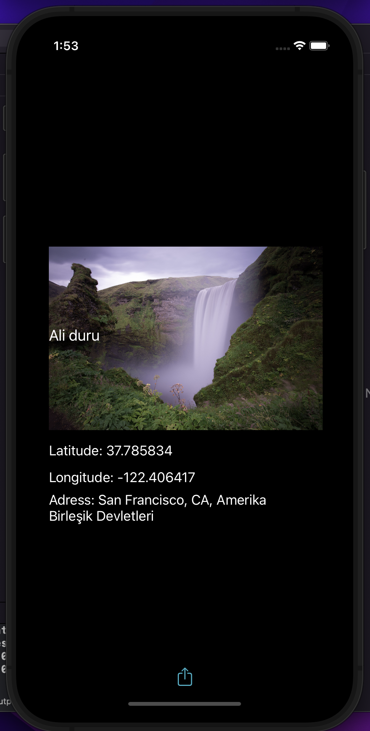
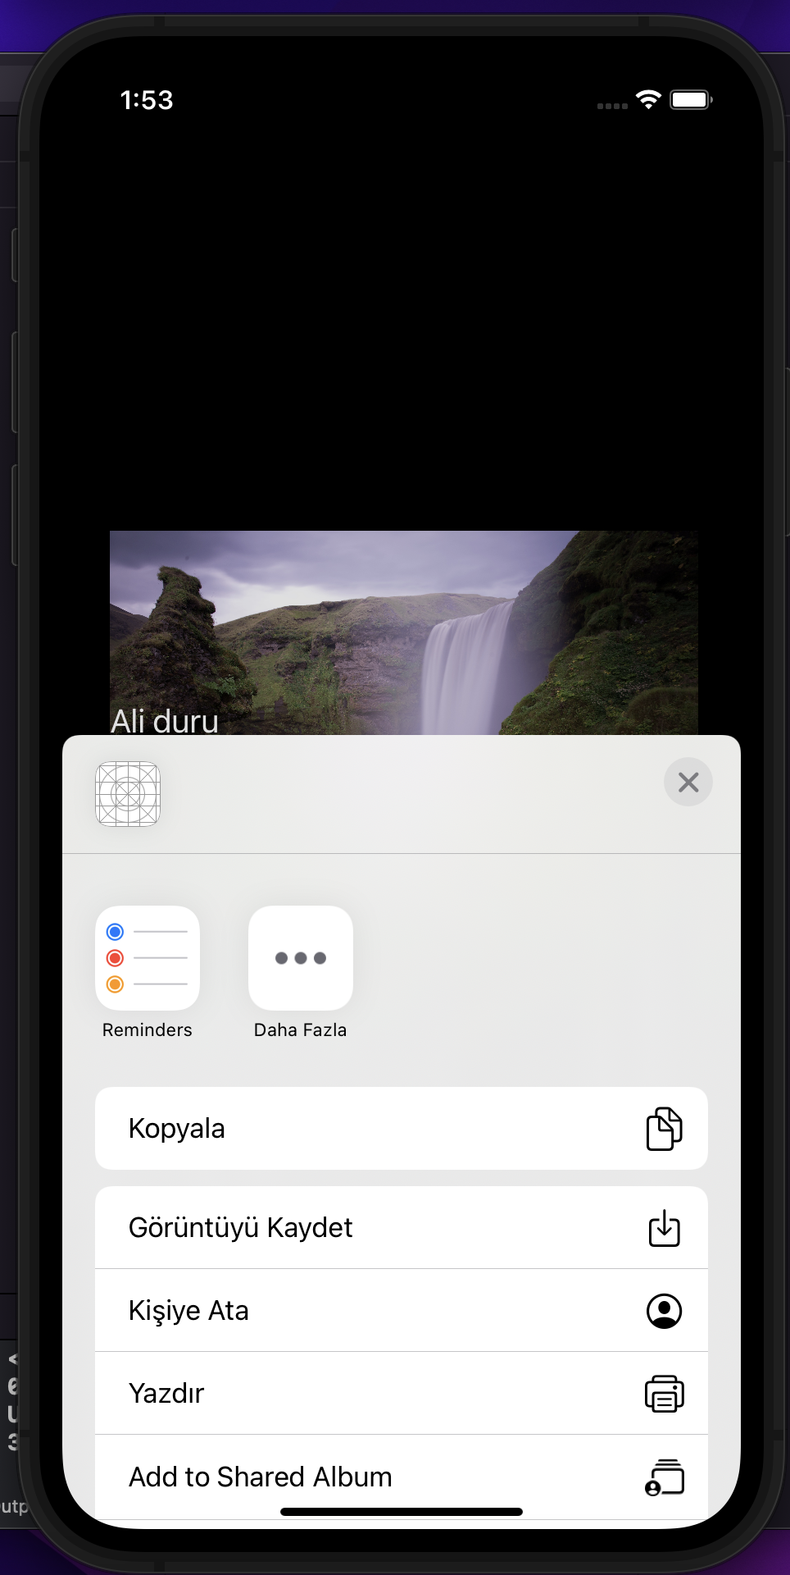

Slide 5
Components Action
tappedEditing
editButton
Libraries
UIKit
Photos
ImageIO
CoreLocation
CoreGraphics

Slide 6
Dinlediğiniz için teşekkür ederim.

